Slide 1
OhioMeansJobs K-12
November 2014

Slide 2
OhioMeansJobs.com
1
Getting Started
User Registration

Slide 3
OhioMeansJobs.com Home Page
Tip: icons below “Search Jobs” are for adult job seekers, and will not direct users to OhioMeansJobs K-12.
Notes:
Timeline:
April 2014: Initial registration begins
July 2014: K-12 site is fully functional
September 2014: K-12 site is ready for official rollout after final testing
All users will be directed to OhioMeansJobs.com, select “Individuals: GET STARTED” and then choose K-12 student (cardinal with the grad cap “OWEN”) to get started with OMJ K-12.

Slide 4
OhioMeansJobs.com: Choose K-12 Student
Tip: always look for the cardinal with the graduation cap, OWEN. He will provide tips and help as you use OhioMeansJobs K-12. Remember to always click on OWEN wearing his graduation cap to enter OhioMeansJobs K-12, when visiting OhioMeansJobs.com.
Notes:
Timeline:
April 2014: Initial registration begins
July 2014: K-12 site is fully functional
September 2014: K-12 site is ready for official rollout after final testing
All users will be directed to OhioMeansJobs.com and then instructed to choose K-12 student (cardinal with the grad cap “OWEN”) to get started with OMJ K-12.

Slide 5
OhioMeansJobs K-12
Tip: click Get Started On My Own to begin registration.

Slide 6
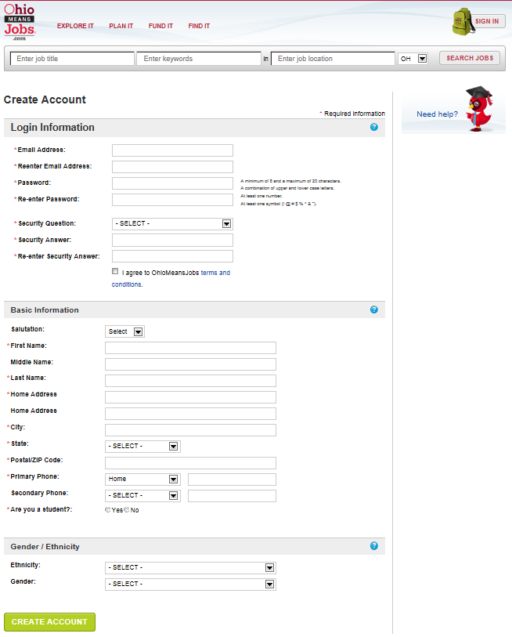
Create Account
Login Information
An email address is required for your “username”. The next slide includes help for creating a free email if you don’t already have one.
Basic Information
Name and address are used when creating a résumé and should reflect formal, given names rather than nicknames.
Gender/Ethnicity are optional and do not require a response for creating an account.
Tip: items with a red asterisk (*) are required. Click ( ) for help with this section.

Slide 7
Login Information
LastName1stInitial@tigertown.com
Example:
RossR@tigertown.com
1. Enter your email address.
Note: If you don’t have an email address, you can:
get free email at Google, Yahoo, or Hotmail
ask your parent or teacher for help
2. Re-enter your email address in the space provided.
Tip: items with a red asterisk (*) are required.

Slide 8
Password
LastName#LunchNumber
Example:
Ross#12345678
(note the Cap Letter and # Symbol)
1. Enter your password
At least 8 but no more than 20 characters
Both upper and lower case letters
At least 1 number and 1 symbol (! # $ % ^ *)
2. Re-enter your password in the space provided.
Tip: write down your email address and password. Keep them in a place that you can access easily in case you forget them later.

Slide 9
Security Question and Answer
tiger
1. Choose a Security Question from the list provided.
2. Enter your Security Answer.
3. Re-enter your Security Answer.
Tip: write down your Security Answer. Keep it in a place that you can easily access later in case you forget it later.

Slide 10
Terms and Conditions
1. Click on the Terms and Conditions link to view the terms for using the OhioMeansJobs website.
Ask your teacher or parents if you have any questions.
2. Click on the check box to agree to the terms (required to create your account).
Tip: Terms and Conditions include privacy policy for OhioMeansJobs and any rules for using the site.

Slide 11
Basic Information
1. Enter your contact information in the required fields.
2. This information is also used for your résumé, so enter your given name and not a nickname.
3. Select the “yes” bubble for student. Once you do this, you can enter information about the school you attend. Teachers and parents will choose the “no” bubble and then select teacher or parent.
4. School Name, District and County are “auto-fill fields”. This means that when you start typing a list of options will appear. For example, if you type “east” all schools matching all or part will appear. Then, select your school from the list. If your school does not appear, enter the entire name in the box without selecting from the list.
5. Parent’s email is optional. If you don’t know it now, you can always add it later.
Tip: if you don’t know your district or county, ask a teacher or parent. You can always change this information later in your Account Settings.

Slide 12
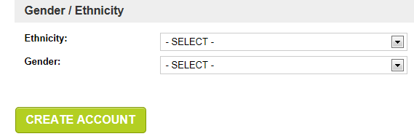
Create Account
1. Gender/Ethnicity is optional and does not require a response to create your account.
2. The next two pages are also optional.
3. Click Create Account to complete the OhioMeansJobs K-12 registration.
Tip: the next two pages are optional.

Slide 13
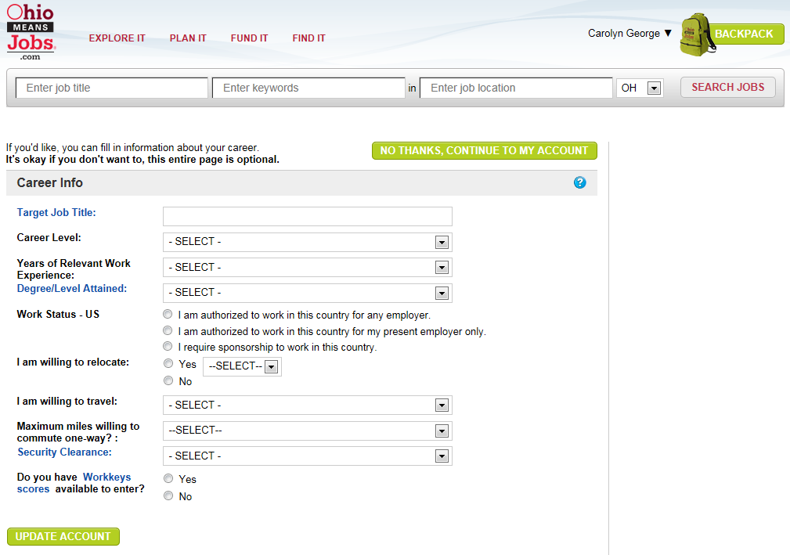
Create Account
Tip: your account is now created and your name appears at the top, right corner of the page next to the Backpack. This page is optional - Click No Thanks, Continue To My Account.

Slide 14
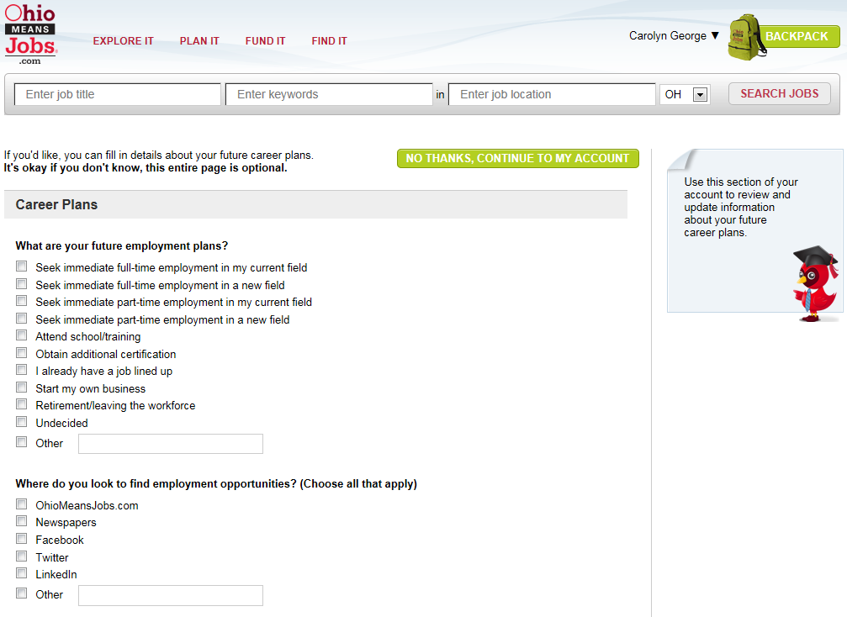
Create Account
Tip: this page is optional - Click No Thanks, Continue To My Account.

Slide 15
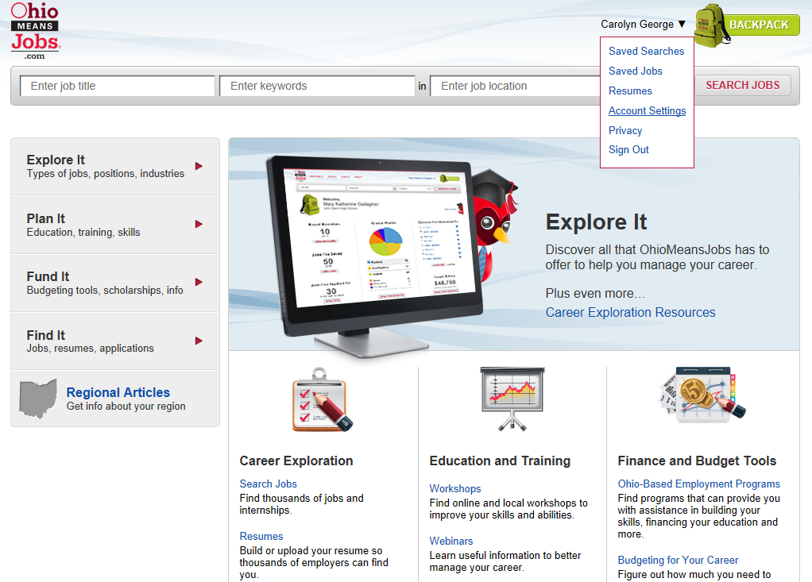
Account Settings
Tip: Account Settings allow you to view and update your information.

Slide 16
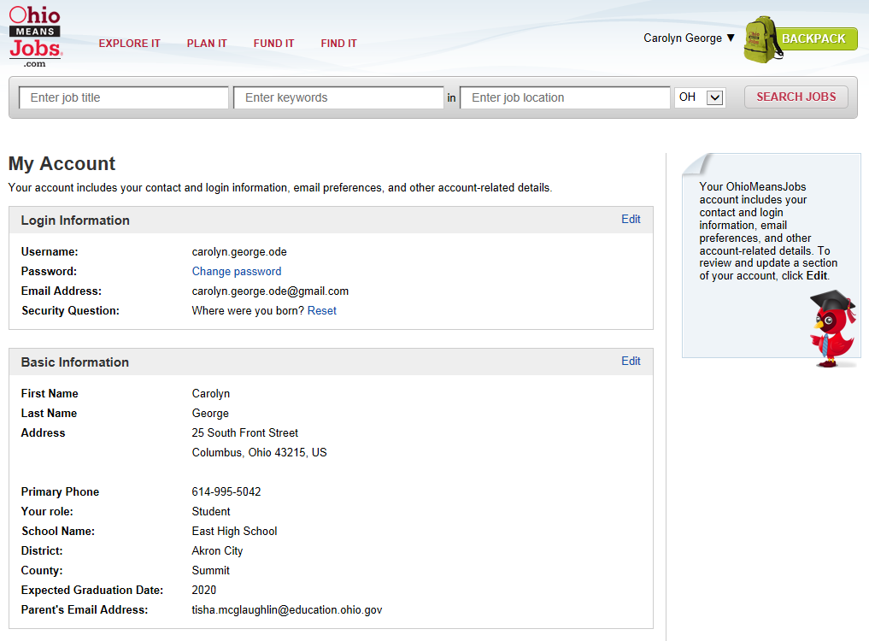
Account Settings
Tip: click Edit to update your information.

Slide 17
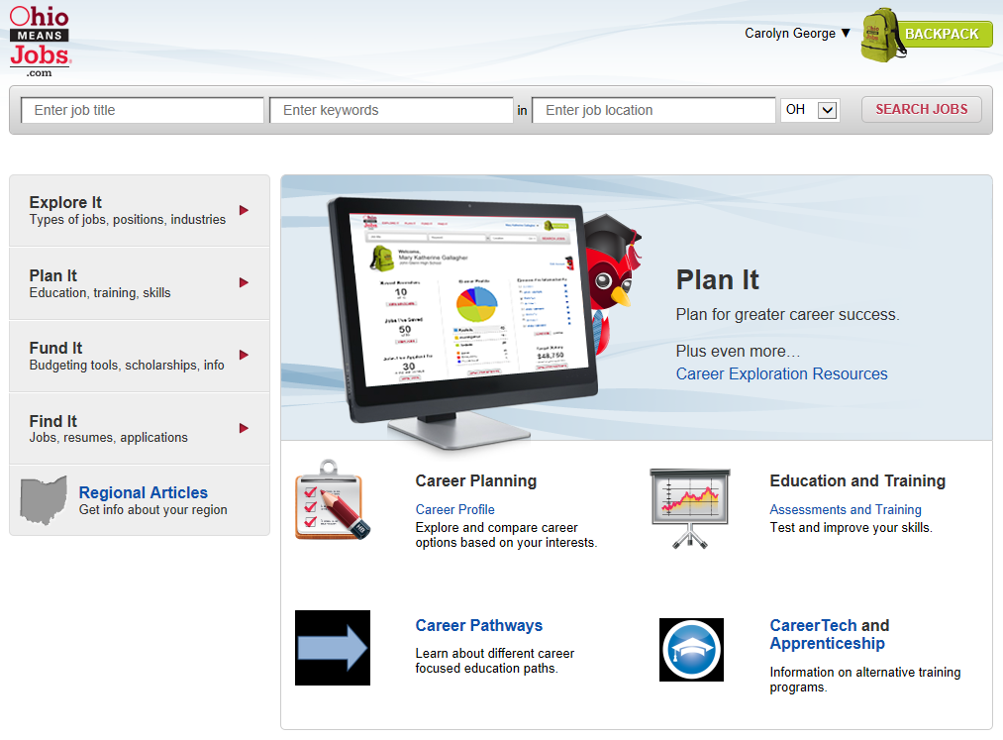
Backpack
Tip: after you log in, you can access your Backpack from any screen by clicking in the top-right corner.

Slide 18
Backpack
Tip: from your Backpack homepage, you can edit your account information, print and access what you’ve saved and continue assessments or planning.

Slide 19
Questions?
Carolyn George
Carolyn.George@education.ohio.gov | 614-995-5042
Tisha McGlaughlin
Tisha.McGlaughlin@education.ohio.gov | 614-466-5756
Career Connections
Office of Career-Technical Education
25 S. Front Street, Columbus, Ohio 43215 | 800-700-6247
Notes:
If you have questions, feel free to contact me:

Slide 20
education.ohio.gov/CareerConnections

Slide 21
Social Media
Ohio Families and Education
Ohio Teachers’ Homeroom
ohio-department-of-education
storify.com/ohioEdDept
@OHEducation
OhioEdDept

